Slide 1
FORSbase
SEEDS meeting
May 5th, 2015, Lausanne Bojana Tasic

Slide 2
FORSbase Strategic Vision Technical View
FORS Web
...
...
International site
...
Inventory &
Archive
Survey Tool
(ex SHP)
… Tool
Catalogue Tool (Compass)
...
Tools
Common Functions
...
...
Metadata
Archive Metadata
Survey Metadata
… Metadata
BFS Metadata
Primary Research Data
...
...
BFS
Primary Data
FORSbase

Slide 3
Schedule
Version 1.0
Research Inventory
Summer 2013
Version 2.0
Data Archive
December 2015
Version 3.0
Survey Tool
2016

Slide 4
DARIS FORS:
Research inventory (10,000 project descriptions, 15,500 researchers and 4,000 institutions)
Data catalogue (400 datasets)
Needs:
Services covering the entire life cycle of research data
Simplified archiving and publishing
Simplified access
Promotion of secondary analysis
Renewal of the infrastructure
Integrated workspace for collaborators and researchers

Slide 5
FORSbase characteristics
A work environment for social scientists and FORS collaborators
Support for the entire data life cycle
Integrated data storage for primary data and metadata
Data preparation and exchange via standards (DDI etc.)
OAIS compliant data archive

Slide 6
Big Picture Inventory & Archive
Users
Researcher/ Producer
FORS Collaborator
Researcher/ Consumer
FORSbase
Processes
Study
Elaboration
Submission
Quality Assurance
Publication/Archive
Search, Browse
Download
Future Process
Environment
Personal
Workspace
FORS
Workspace
Unified Search, Browse, Filter, Access
Future
Module
Global
Functions
Communication, Messaging etc.
Modules
Workspace
FORS Archive
Compass
Project
Inventory
NESSTAR
Adaptor
Future
Module
Ingest
Manage
Access
Repo- sitory
FA
OR

Slide 7
Big Picture Inventory & Archive
Users
Researcher/ Producer
FORS Collaborator
Researcher/ Consumer
Processes
Study
Elaboration
Submission
Quality Assurance
Publication/Archive
Search, Browse
Download
Future Process
Environment
Personal
Workspace
FORS
Workspace
Unified Search, Browse, Filter, Access
Future
Module
Global
Functions
Communication, Messaging etc.
Modules
Workspace
FORS Archive
Compass
Project
Inventory
NESSTAR
Adaptor
Future
Module
Ingest
Manage
Access
Repo- sitory
FA
OR

Slide 8
Big Picture Inventory & Archive
Users
Researcher/ Producer
FORS Collaborator
Researcher/ Consumer
Processes
Study
Elaboration
Submission
Quality Assurance
Publication/Archive
Search, Browse
Download
Future Process
Environment
Personal
Workspace
FORS
Workspace
Unified Search, Browse, Filter, Access
Future
Module
Global
Functions
Communication, Messaging etc.
Modules
Workspace
FORS Archive
Compass
Project
Inventory
NESSTAR
Adaptor
Future
Module
Ingest
Manage
Access
Repo- sitory
FA
OR

Slide 9
Big Picture Inventory & Archive
Users
Researcher/ Producer
FORS Collaborator
Researcher/ Consumer
Processes
Study
Elaboration
Submission
Quality Assurance
Publication/Archive
Search, Browse
Download
Future Process
Environment
Personal
Workspace
FORS
Workspace
Unified Search, Browse, Filter, Access
Future
Module
Global
Functions
Communication, Messaging etc.
Modules
Workspace
FORS Archive
Compass
Project
Inventory
NESSTAR
Adaptor
Future
Module
Ingest
Manage
Access
Repo- sitory
FA
OR

Slide 10
Big Picture Inventory & Archive
Users
Researcher/ Producer
FORS Collaborator
Researcher/ Consumer
Processes
Study
Elaboration
Submission
Quality Assurance
Publication/Archive
Search, Browse
Download
Future Process
Environment
Personal
Workspace
FORS
Workspace
Unified Search, Browse, Filter, Access
Future
Module
Global
Functions
Communication, Messaging etc.
Modules
Workspace
FORS Archive
Compass
Project
Inventory
NESSTAR
Adaptor
Future
Module
Ingest
Manage
Access
Repo- sitory
FA
OR

Slide 11
Big Picture Inventory & Archive
Users
Researcher/ Producer
FORS Collaborator
Researcher/ Consumer
Processes
Study
Elaboration
Submission
Quality Assurance
Publication/Archive
Search, Browse
Download
Future Process
Environment
Personal
Workspace
FORS
Workspace
Unified Search, Browse, Filter, Access
Future
Module
Global
Functions
Communication, Messaging etc.
Modules
Workspace
FORS Archive
Compass
Project
Inventory
NESSTAR
Adaptor
Future
Module
Ingest
Manage
Access
Repo- sitory
FA
OR

Slide 12
Big Picture Inventory & Archive
Users
Researcher/ Producer
FORS Collaborator
Researcher/ Consumer
Processes
Study
Elaboration
Submission
Quality Assurance
Publication/Archive
Search, Browse
Download
Future Process
Environment
Personal
Workspace
FORS
Workspace
Unified Search, Browse, Filter, Access
Future
Module
Global
Functions
Communication, Messaging etc.
Modules
Workspace
FORS Archive
Compass
Project
Inventory
NESSTAR
Adaptor
Future
Module
Ingest
Manage
Access
Repo- sitory
FA
OR

Slide 13
DEMO
forsbase.unil.ch

Slide 14
Big Picture Survey Tool
SPSS
SAS
R
Data
Treatment
check &
enhance data
🔍
Labeled
Data
update
data
Primary
Data
conduct
survey
Results
Process
Data
store
data
🔍
Survey
Institute
🔍
Survey Tool
new
questions
1) Question?
☐ a ☐ c ☐ b ☐ d
2) Question?
☐ 1 - 10
☐ 11 - 50
☐ 51 - 100
EN
Question DB
DE
publish
data & metadata
FR
re-use
questions
✔
old
questionnaires
order
translation
validate
questionnaire
import &
export
EN
Trans-lations
DE
XML
Web
FR
"Tester"
PDF

Slide 15
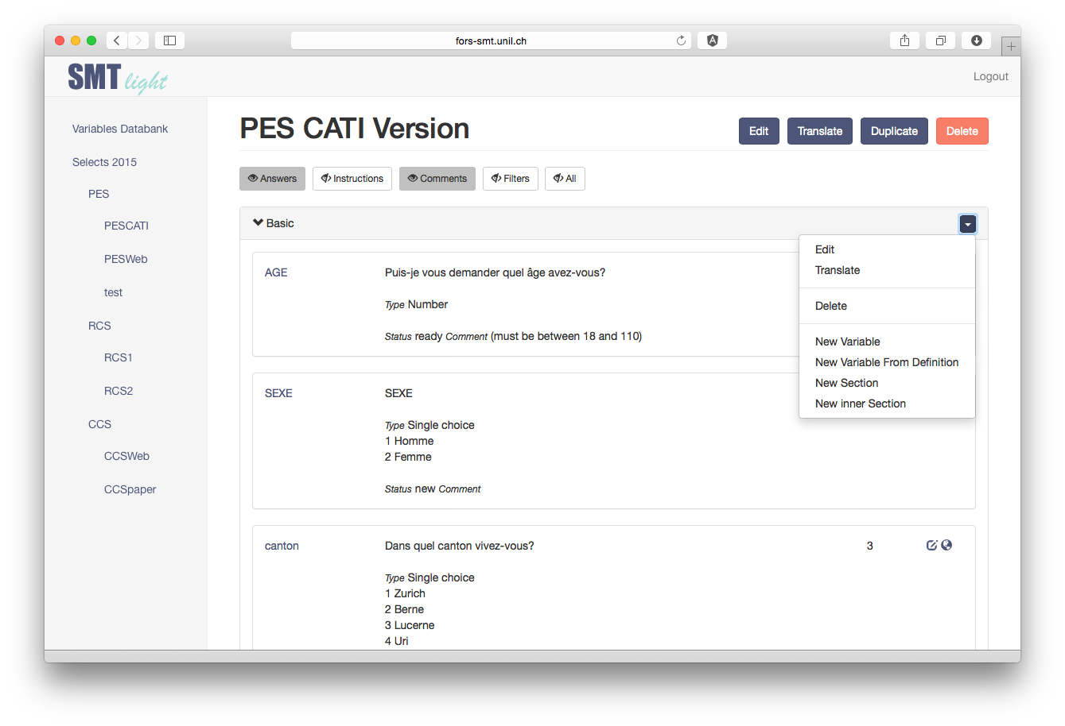
SMT^{light}

Slide 16
SMT^{light} Requirements
Questionnaires
Create/edit/delete questionnaires and duplicate existing ones
Export from/to Excel format
Simple versioning
Questions
Create/edit/delete questions in multiple languages
Link questions (to different questionnaires)
Search and edit all occurrences of one question
Link questions to answer categories
Maintain some metadata per question (status, origin, …)
Filters
Group questions in sections, reorder questions

Slide 17
DEMO

Slide 18
Any questions?

