Slide 1
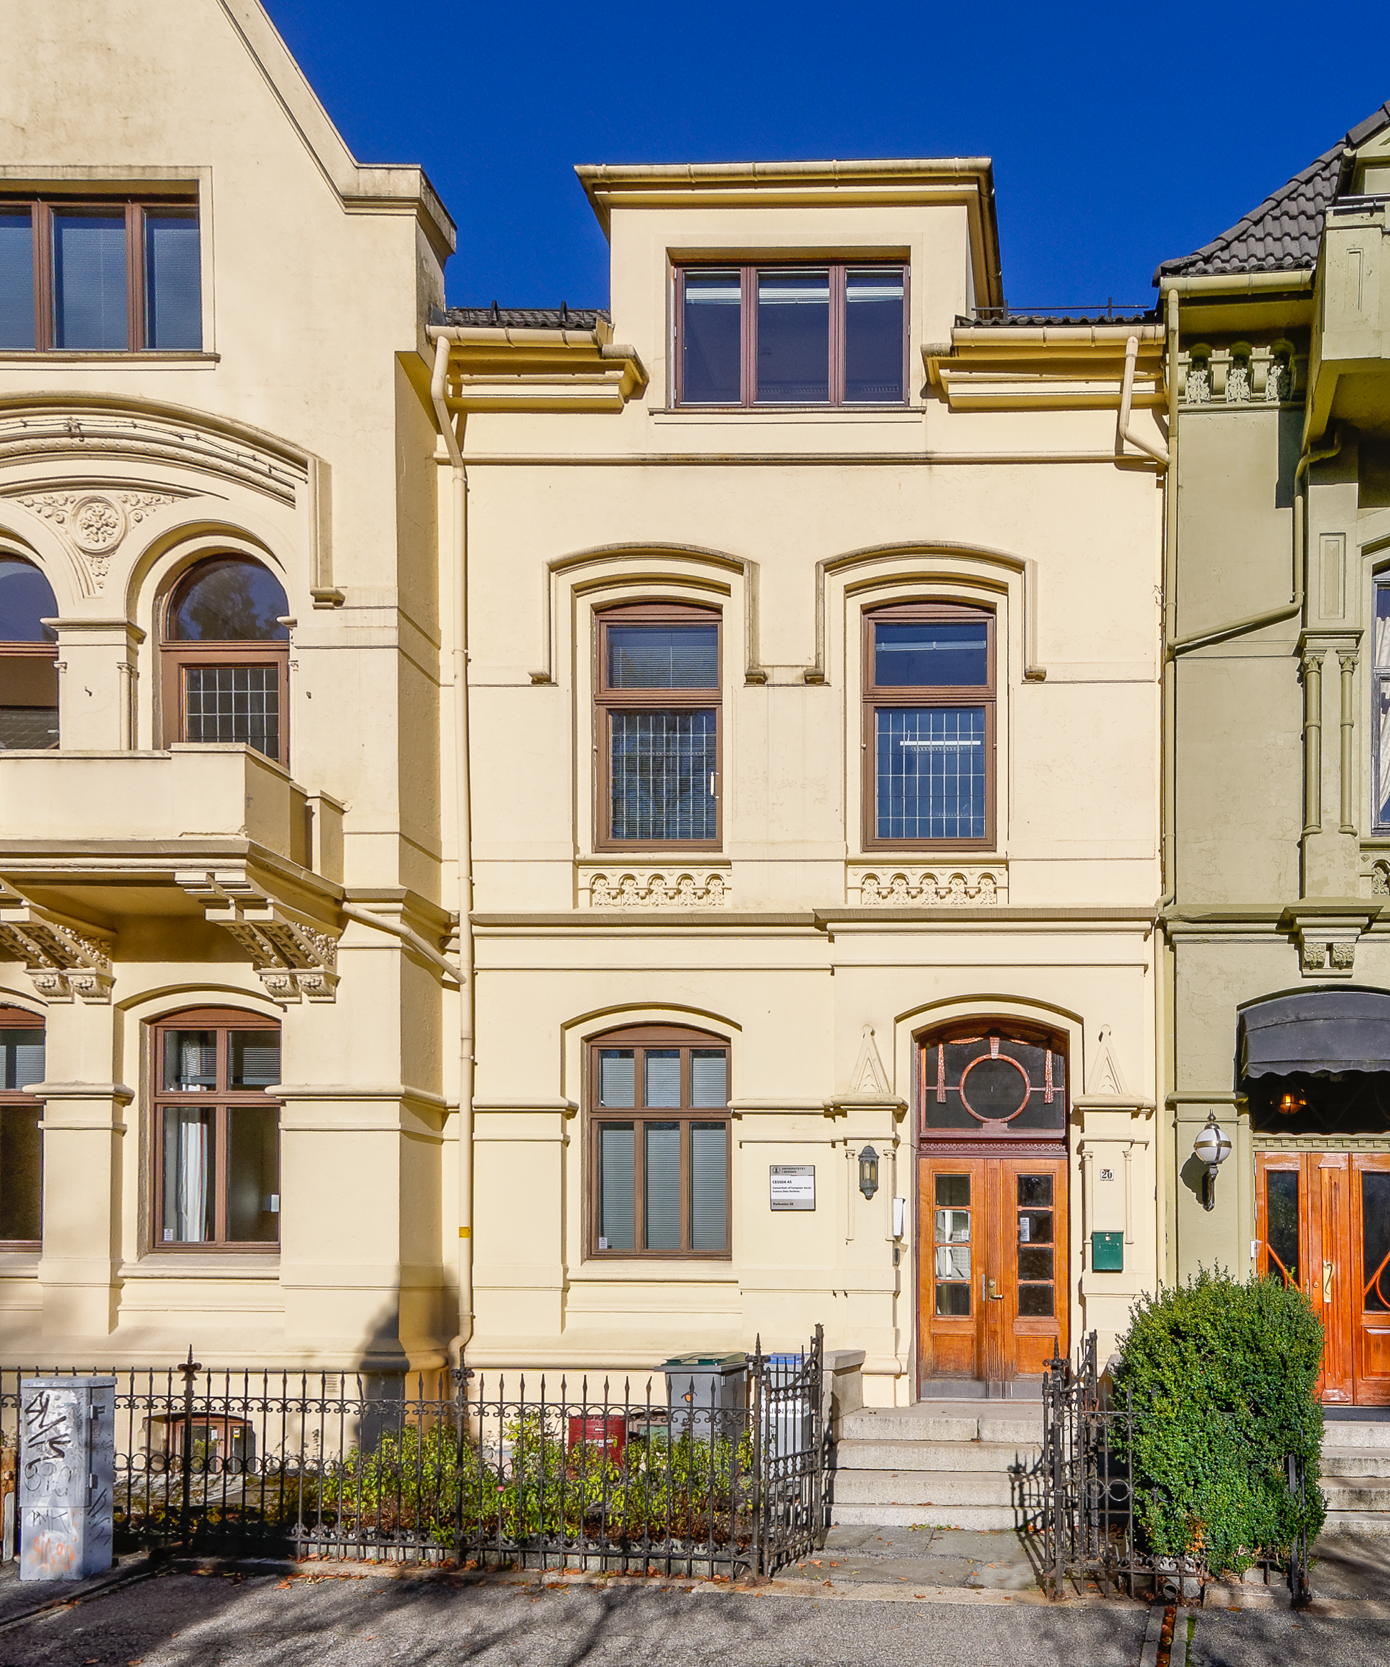
CESSDA – for what and for whom?
SEEDS project meeting, Zagreb, 02 November 2016

Slide 2
What is CESSDA?
15 (16) members:
Austria
Belgium
Czech Republic
Denmark
Finland
France
Germany
Hellas
Lithuania
Netherlands
Norway
Slovenia
Sweden
Switzerland
UK
Slovak Republic (Observer)
10 countries with activities aiming at membership:
Bulgaria
Croatia
Estonia
Hungary
Ireland
Italy
Portugal
Romania
Serbia
Spain
CESSDA means:
Cross-European resource discovery
Improved quality of data and metadata
A wider selection of comparable data
Certification of data archiving organisations
Professional training for data archivists
Improved mechanisms for data dissemination and analysis
Strong involvement of organisations outside Europe

Slide 3
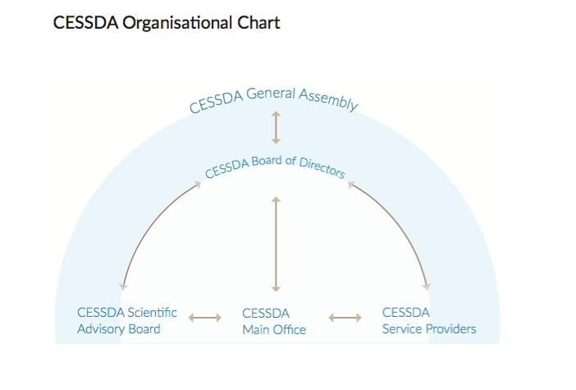

Slide 4
Working groups
CESSDA Trust support group (SaW)
CESSDA Technical Group
CESSDA Training group
CESSDA Communications group (ongoing)
Evaluation of activities (yearly basis)
Proposal of tasks for Work Plans
Engagement of SPs (transparency)
Contacts in each SP (CMM, TSG)
..…

Slide 5
Mission
The mission of CESSDA is to provide a full scale sustainable research infrastructure that enables the research community to conduct high-quality research in the social sciences which can contribute inter alia to effective solutions to the major challenges facing society today.

Slide 6
CESSDA Activities
Coordinating the network of European data service providers and promotion of the results of social sciences;
Facilitating researcher access to important resources of relevance to the European social science research agenda regardless of the location of either researcher or data;
Working continuously to include further data sources from Europe and beyond, into the infrastructure;
Providing training within CESSDA and beyond on best practices surrounding operational processes and data management;
Promoting and facilitating wider participation in CESSDA;
Developing and coordinating of standards, protocols and professional best practices pertaining to the preservation and dissemination of data and associated digital objects.

Slide 7
CESSDA Work Plans
CESSDA Work Plan Tasks (internal projects)
CESSDA external projects (EU projects)
WP2015
WP2016
WP2017
WP2018
CESSDA SaW 2015-2017
SERISS 2015-2019
Big Data Europe 2015-2018
RISCAPE 2017 - 2020

Slide 8
Work Plan Tasks 2015
Funded projects:
CESSDA Metadata Management (FSD + ADP, CASD, DDA, GESIS, NSD, SND, UKDS ) – until April 2017
Data Access and Dissemination Policy (UKDS, all SPs)
Technical Framework (UKDS + NSD, DANS, SND, GESIS)
Open Source Metadata Harvester (NSD + UKDS, FSD, SND, DDA)
Expert Seminar 2015 (hosted by DANS)

Slide 9
Work Plan Tasks 2016
1. CESSDA Product and Service Catalogue – Phase 1 Ongoing
2. CESSDA Expert Seminar 2016 - Prague, TWG & CSDA Done
3. CESSDA Technical Framework phase 2 - Ongoing
4. Collaboration with GESIS on CESSDA tasks:
Training modules for “data discovery” Hasn’t started yet!
PID (Persistent Identifier) Services and Training Ongoing
Components of the Question Data Bank Ongoing

Slide 10
Work Plan Tasks 2017 - proposals
CESSDA Expert Seminar 2017
CESSDA Product and Service Catalogue phase 2
CESSDA Metadata Management phase 2
CESSDA Technical Framework phase 3
CV Manager
PID Services phase 3*
Training (Data Discovery Workshops and Collaborative data management module for comparative social science researchers*
EQB phase 3*
Trust Work Plan 2017 activities (SaW)**

Slide 11
ERIC process
CESSDA on its way to become an European Research Infrastructure Consortium (ERIC) owned by the European Ministries
Formal process started in April 2015
Finalisation expected in 2017
Members:
EU Member States
Associated countries
Third countries other than associated countries
Intergovernmental Organizations

Slide 12
ESFRI- European Strategy Forum for Research Infrastructures
2002 – established with mandate from EC to support a coherent and strategy-led approach to policy-making on research infrastructures in Europe
2006 – first roadmap for the next generation of Pan -EU RIs (48 projects)
2008 – 1st update
2011 – 2nd update
2014 - ESFRI Roadmap
2016 - ESFRI Landmarks (5 in SSH)
Sustainability:
1) financially and organisationally,
2) technically, and
3) in terms of human resources.

Slide 13
THANK YOU!

