Slide 1

Access
Irena Vipavc Brvar
ADP
SEEDS Workshop I
Belgrade, 13-15 October

Slide 2

For WHOME and HOW
My users – researchers, student /educational
Public / commercial
Related to licenses
Web page
Safe room / secure access
Cloud / encription
DISSEMINATION POLICY

Slide 3
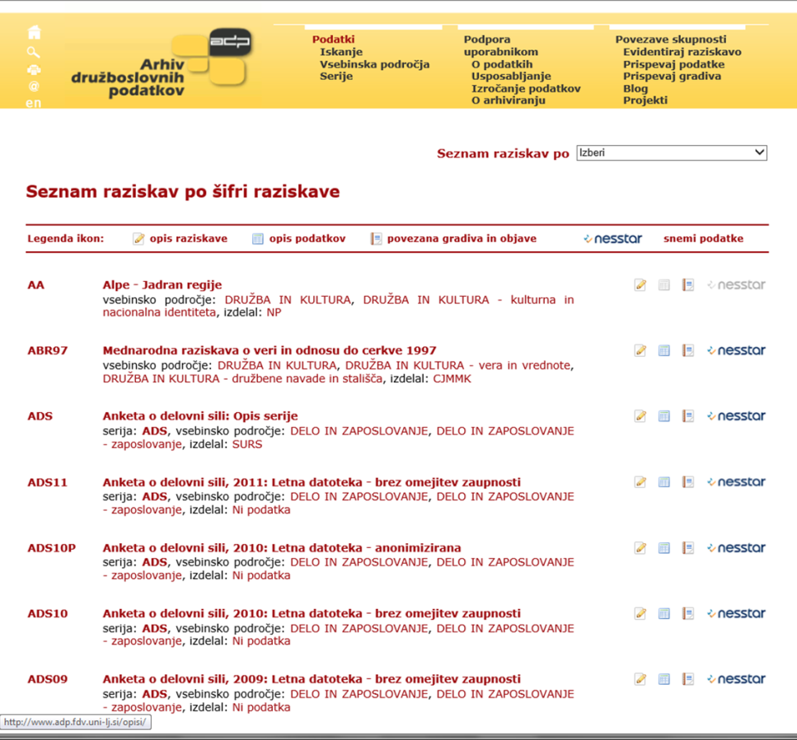
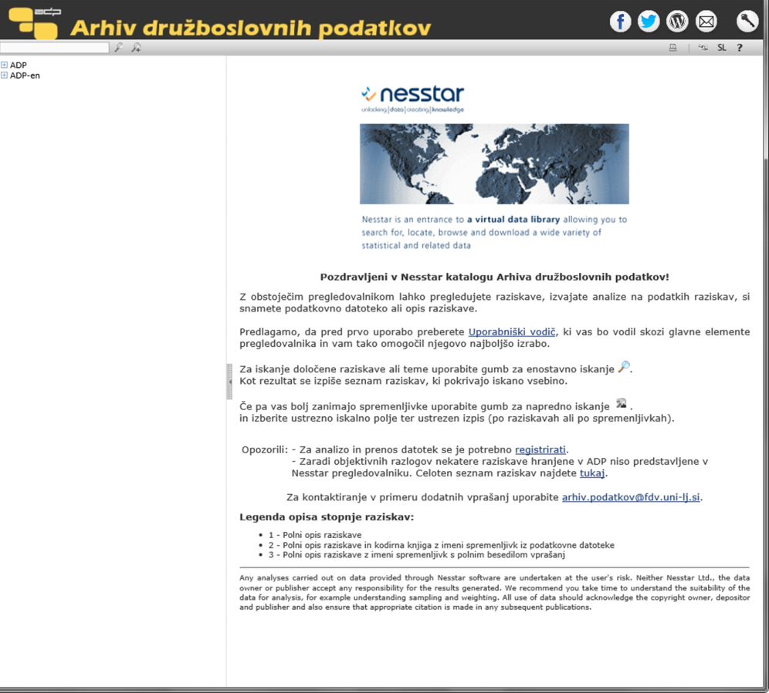
How to access data at ADP
WEB page
www.adp.fdv.uni-lj.si
NESSTAR
http://nesstar2.adp.fdv.uni-lj.si/
  What you can find on our page?
    Study description
    Data description
    Related materials and publications
  What you can find on Nesstar?
    + ….
    On-line analysis

Slide 4
Managing access to data
Open
Safeguarded
Controlled
available for download/online access under open licence without any registration
available for download/online access to logged-in users who have registered and agreed to an End User Licence
available for remote or safe room access to authorised and authenticated users whose research proposal has been and who have received training
Veerle Van den Eynden, 2015

Slide 5
Access
ACCESS CONDITIONS IN NESSTAR
 | freeStudy |  | publStudy |  | acadStudy |  | adminStudy |  | USE | What I‘ll do with the.
 | A | D | A | D | A | D | A | D
academic | Y | Y | Y | N | Y | N | N | N | educational, scientific, public | Web analysis
fullacademic | Y | Y | Y | Y | Y | Y | N | N | educational, scientific, public | Download locally
nonacademic | Y | Y | Y | N | N | N | N | N | Commercial | Web analysis
fullnonacademic | Y | Y | Y | Y | N | N | N | N | Commercial | Download locally
Anonymous | Y | Y | N | N | N | N | N | N | all | everything

Slide 6

Regulate access where needed (all or part of data) by group, use, time period
Open access
- survey description –metadata,
related materials and publications,
questionnaire,
frequency and descriptive analysis - summary statistics
Registration needed
- On-line analyzes (Nesstar)
Download of data
Special conditions apply for access to more restricted datasets (Safe-room environment)

Slide 7
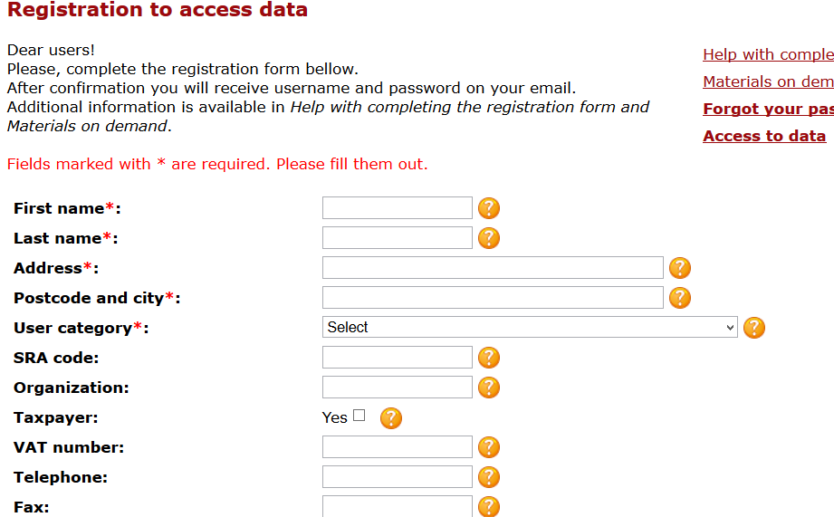
…..Defining the purpose of use, survey that will be used….

Slide 8
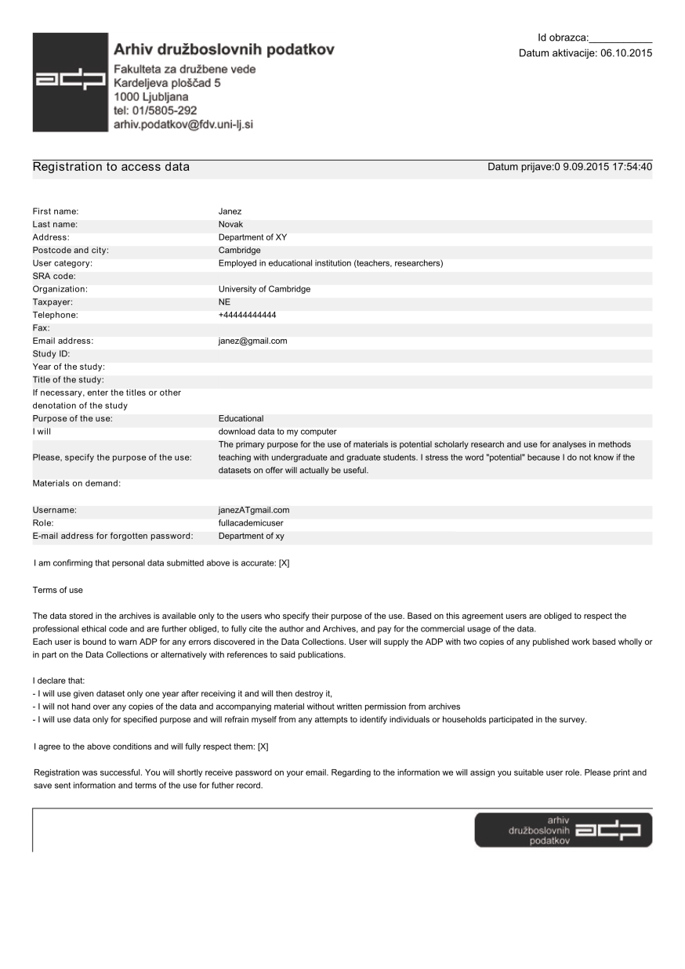
Forms and documents
Registration of users
Help with completing the
registration form
(http://www.adp.fdv.uni-lj.si/registracija/)

Slide 9
Terms of use
The data stored in the archives is available only to the users who specify their purpose of the use. Based on this agreement users are obliged to respect the professional ethical code and are further obliged, to fully cite the author and Archives, and pay for the commercial usage of the data.
Each user is bound to warn ADP for any errors discovered in the Data Collections. User will supply the ADP with two copies of any published work based wholly or in part on the Data Collections or alternatively with references to said publications.
I declare that:
- I will use given dataset only one year after receiving it and will then destroy it,
- I will not hand over any copies of the data and accompanying material without written permission from archives
- I will use data only for specified purpose and will refrain myself from any attempts to identify individuals or households participated in the survey.
I agree to the above conditions and will fully respect them.
I want to receive ADP newsletter.

Slide 10
Using materials
Need for proper guides /web + documents
Guide for access:
Video guide for search via Nesstar
Tools for search and work with research data
User Workshops!!!!
For researchers, students, topic specific
Support – from professors, librarians
Different universities, national libraries,
governmental departments

Slide 11
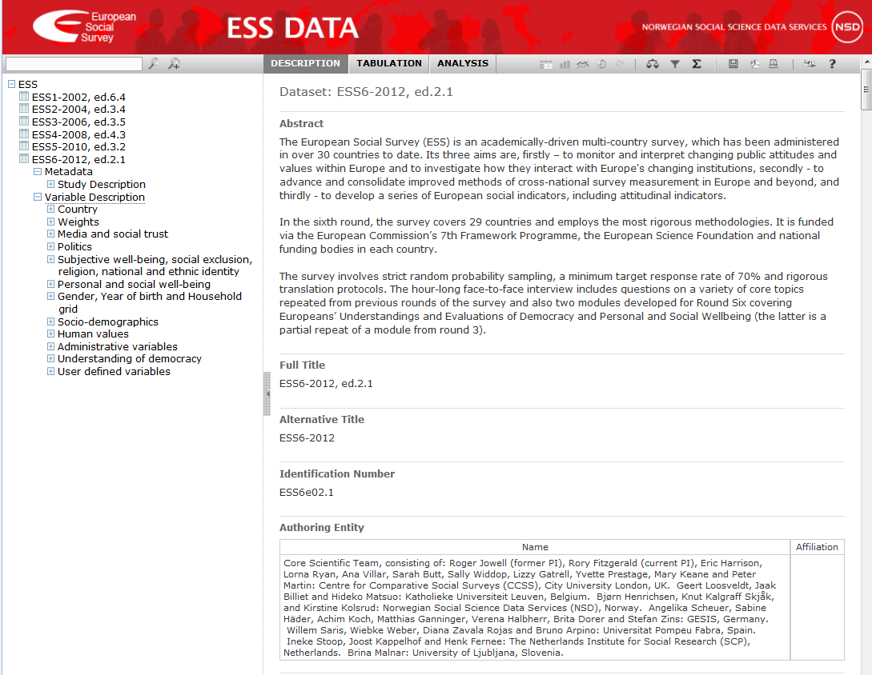

Slide 12

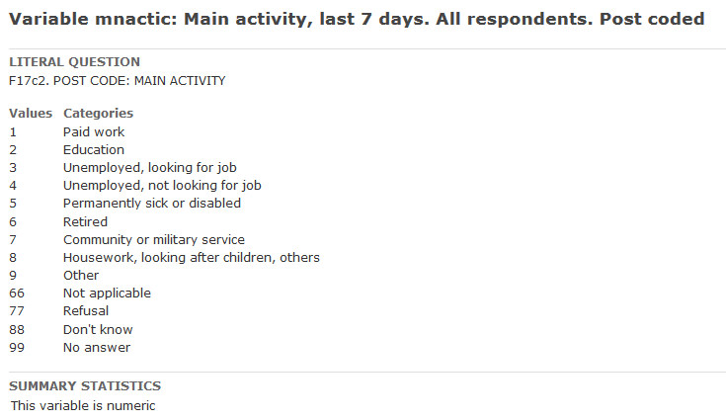
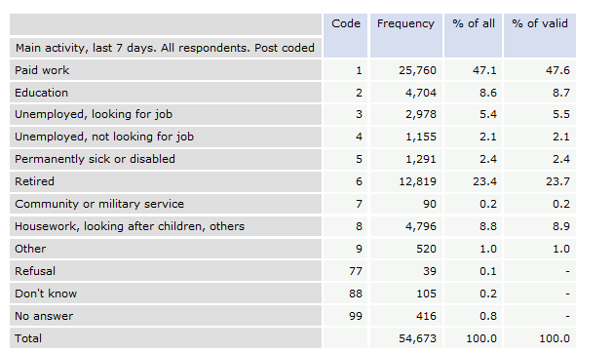
Let’s start with a simple exercise comparing life satisfaction measures of two groups – the unemployed people looking for work versus people in paid work. Calculate the means for the two groups across Europe.
Source: European Social Survey, 2014

Slide 13
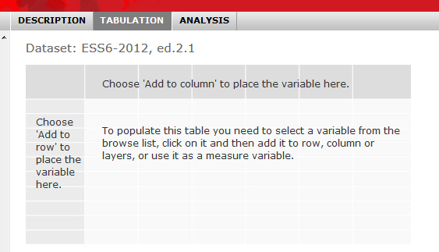
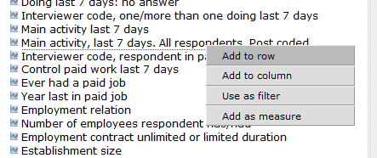
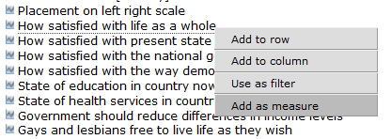
Socio-demographics
Politics
Source: European Social Survey, 2014

Slide 14
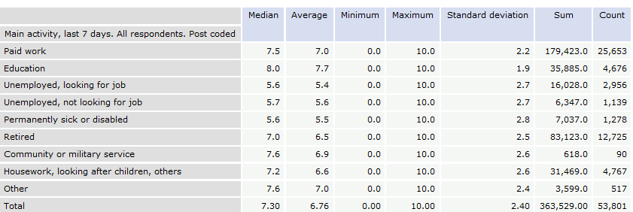
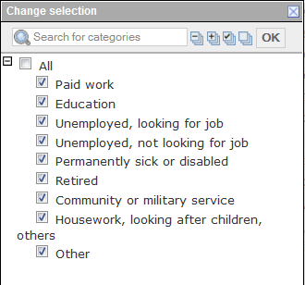
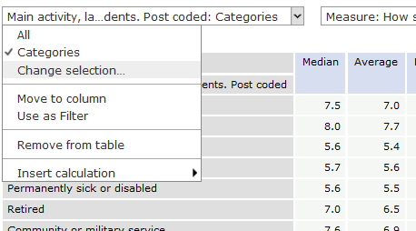
B20. All things considered, how satisfied are you with your life as a whole nowadays?
Source: European Social Survey, 2014
Source: European Social Survey, 2014

Slide 15

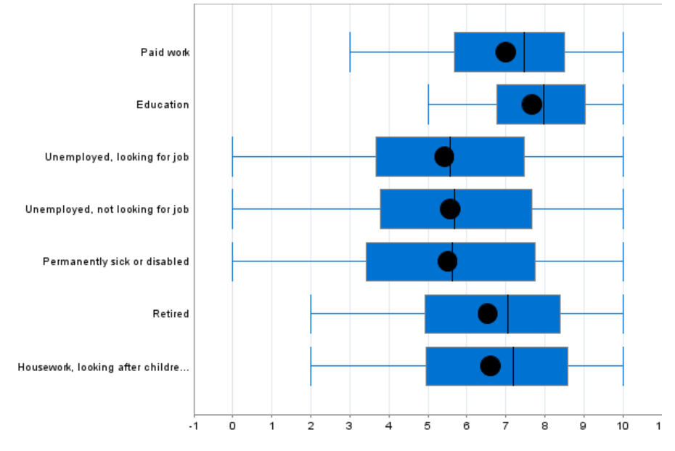
Satisfaction with life vs. employment
Source: European Social Survey, 2014

Slide 16
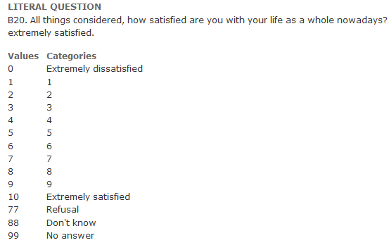
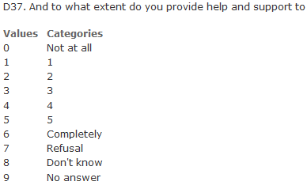
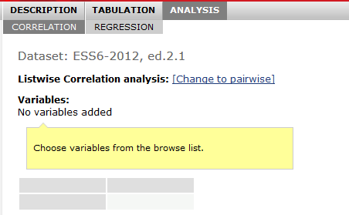
Next, let’s confirm the correlation between providing help and life satisfaction. Is it significant? Make sure you check variables response codes to be sure – for ex. do high numbers mean satisfaction or do they mean low satisfaction? Use the variables ‘(B20) How satisfied with life as a whole’ and ‘(D37) Provide help and support to people you are close to’.
Source: European Social Survey, 2014

Slide 17


Official statistics data
Access to data in ADP(PUF, SUF) and Safe room environment in Statistical Office of RS (ScUF).
ADP preparing standard documentation (compete package) that is available in SORS.
Special thematic workshops.

