Slide 1
Preservation Planning
Bojana Tasić
FORS
SEEDS Workshop I
Belgrade, 13-15 October

Slide 2
The Open Archival Information System model

Slide 3
Preservation Planning

Slide 4
Main functionalities
Monitor the environment
Provide recommendations and preservation plans
Create/maintain policies
Technology watch

Slide 5
Monitor the environment
Monitor the user community, user preferences
Gathering information from users
Online survey tools
Focus groups

Slide 6
Monitor the environment
Develop preservation strategies
Develop standards
Design Information Package

Slide 7
Monitor the environment
Monitor the community
What do they want?
Monitor technology
How can we deliver data?

Slide 8
Preservation plans and policies
File formats
Information Package design
Long term preservation
Risk management
Management of access permissions and restrictions

Slide 9
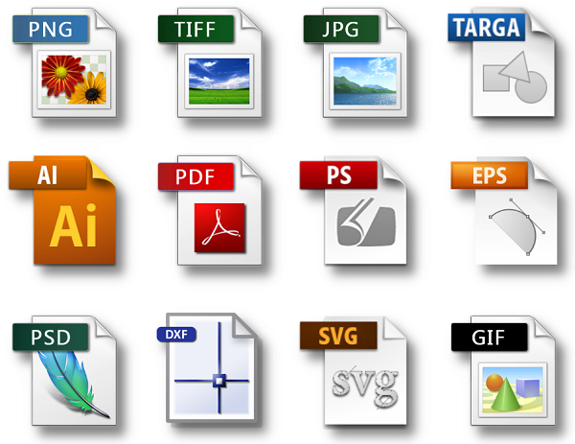
File formats
File formats encode information into a form that can only be processed and rendered by very specific combinations of hardware and software

Slide 10
Why a data archive should be concerned with file formats?
They exist in big numbers
Relevant during the whole workflow
Largely proprietary
Subject to rapid obsolescence

Slide 11
Criteria for selecting target formats
Ubiquity
Support
Documentation quality
Stability
Ease of identification and validation
Intellectual Property Rights
Metadata Support
Complexity
Interoperability
Viability
Re-usability

Slide 12
Information Package design
Defining metadata
Selection of file formats for SIP, AIP and DIP
Notes:
Submission format - (depends on producer, we can do the influence here)
Archival format – based on standards, what is good for long term preservation, easy to convert, etc.
Dissemination format – What Consumer wants, what’s popular

Slide 13
File formats for SIPs
Tabular data: SPSS portable format (.por), SPSS (.sav), Stata (.dta), Excel or other spread sheet format files, which can be converted to tab- or comma-delimited text), R (.txt)
Text: Adobe Portable Document Format (PDF/A, PDF) (.pdf), plain text data, ASCII (.txt), Rich Text Format (RTF) (.rtf), Microsoft Office and Open Office documents;
Audio: Waveform Audio Format (WAV) (.wav) from Microsoft, Audio Interchange File Format (AIFF) (.aif) from Apple, FLAC (.flac);
Raster (bitmap) images: TIFF (.tif) ideally version 6 uncompressed, JPEG (.jpeg, .jpg), PNG (.png), GIF (.gif) and BMP (.bmp) only when created in this format, Adobe Portable Document Format (PDF/A, PDF) (.pdf);
Vector images: DFX (.dfx), SVG (.svg);
Video: MPEG-2 (.mpg2), MPEG-4 (.mpg4), motion JPEG 2000 (.mj2).

Slide 14
File formats for AIPs
Tabular data: Microsoft Excel File Format (XLS) (.xls), ASCII, Comma Separated Values (CSV) (.csv; .txt)
Text: Adobe Portable Document Format (PDF/A) (.pdf), XML (.xml), Standard Generalised Markup Language (SGML) (.sgml)
Audio: Waveform Audio File Format (.wav)
Raster (bitmap) images: TIFF (.tif)
Vector images: DFX (.dfx), SVG (.svg)
Video: MPEG-2 (.mpg2)

Slide 15
File formats for DIPs
Tabular data: SPSS portable format (.por), SPSS (.sav), Stata (.dta), R (.txt)
Text: Adobe Portable Document Format (PDF) (.pdf), Rich Text Format (RTF) (.rtf)
Audio: MP3 (.mp3)
Raster (bitmap) images: JPEG (.jpg)
Vector images: DFX (.dfx), SVG (.svg)
Video: MPEG-4 (.mpg4)

Slide 16
Long term preservation
Digital preservation approaches when the data is obsolete
Migration
Emulation
Technology preservation

Slide 17
Migration
Changing the format of a file to ensure the information content can be read
Convert digital object from one format to another, so a current process can render it
PROS
CONS
Can retain ‘look and feel’ of original digital object
Data maintained in current and accessible format
Widely used; procedures exist
Conversion software exists
Potential losses: formatting, data, functionality, look and feel
Extra work need for each format type
Plan and implement work cycles
Needs preservation metadata
Notes:
Losses:
These losses may be invisible or unnoticed
Losses can get worse the more migrations you do

Slide 18
Migration - Things to consider
File made by migration is a new copy
Always keep the original
How many migrations will you keep

Slide 19
Emulation
Keep the source in its original format
Attempt to recreate the process to replay the performance on current computers
e.g. virtual machine with the OS and application
PROS
CONS
Original data not altered
May be more authentic
Maintains integrity
Efficient
One emulator solves many problems
Technically complex
Need to preserve old applications and operating systems
Emulator itself will have to be preserved
Needs updates
Notes:
Losses:
These losses may be invisible or unnoticed
Losses can get worse the more migrations you do

Slide 20
Technology preservation
Keep the digital object AND all hardware / software necessary for performance
Keep the environment
(Maintain a computer museum :)
PROS
CONS
Arguably effective and “obvious”
Requires commitment to finding, acquiring, programming, maintaining old hardware
Machines and computer chips will degrade
Technical support is not guaranteed
Space!
Notes:
Losses:
These losses may be invisible or unnoticed
Losses can get worse the more migrations you do

Slide 21
Preservation strategy/policies – things to consider
Is it a strategy your organisation can work with?
Is it sustainable?
What are the cost implications?
What do you need to plan for?
What could happen in the long term?
What about the needs of your user community?
How it’s done in similar institutions?
Are there some standards you should follow?
Notes:
Losses:
These losses may be invisible or unnoticed
Losses can get worse the more migrations you do

Slide 22
Risk management
Risks affecting your organisation
Risks in your repository
Risks in using certain tools
Procedures for dealing with risk

Slide 23
Management of access permissions and restrictions
Data deposit agreement
Describes the legal framework under which material is deposited and states the rights and responsibilities of both parties – the depositor and the archive – regarding copyright and ownership of the data and the access conditions
Covers usage rights, authenticity, data protection responsibilities, and disposal
End user license
Describes the legal framework under which the material is distributed.
Conditions under which a user is granted access to data and how they may use those data

Slide 24
Technology watch
Ongoing process
Define a technology watch scheme for monitoring developments and advances in the digital preservation area and Designed Community
Write reports
Define strategy and future policies

Slide 25

Questions?

