Slide 1
OAIS model
Bojana Tasić
FORS
SEEDS Workshop I
Belgrade, 13-15 October

Slide 2
The Open Archival Information System model
Represents the archive, consisting of an organization of people and systems, that has accepted the responsibility to preserve information and make it available for a designated community
Framework for understanding the archival concepts needed for long term digital information preservation and access
ISO 14721:2012 (revises ISO 14721:2003)
Notes:
Describes a workflow of any archive that preserves the digital content, not just SS archive

Slide 3
The Open Archival Information System model

Slide 4
Elements
1
Things happen: Functional Entities
2
People make them happen: Actors
3
Data is stored: Information packages

Slide 5
Functional Entities

Slide 6
Information packages

Slide 7
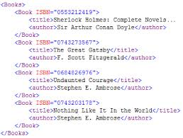

Information packages
IP
+
=
Information
package
Digital object
+
Meta data
=

Slide 8
Information packages
Submission Information Package
Archival Information Package
Dissemination Information Package

Slide 9
Actors

Slide 10
Actors
Producers
  Person, agency or a system, that deposit data (data producers, depositors, researchers)
Consumers
  People who use the data (readers, researchers, academics, public, user community)
Management
  People who work in the archive (data managers, archivists, programmers, database managers, data center managers)

Slide 11
Ingest
Receive submission
Quality assurance
Transform SIP into AIP
Extraction of descriptive metadata
Transfer of the AIP to Data Management and Archival Storage

Slide 12
Data Management
Manage metadata in database
Keep a record of actions
Manage UIDs
Perform queries on databases
Generating reports

Slide 13
Archival Storage
Store AIP (physical files)
Media migration
Media replacement
Disaster recovery
Security

Slide 14
Preservation planning
Monitor the environment
Provide recommendations and preservation plans
Policies
Technology watch

Slide 15
Administration
Auditing submissions
Negotiating with Producers
Managing the configuration of the system
Ensure that the system conforms with policies

Slide 16
Access
Services and functions that support Consumers
Generate and deliver DIP

Slide 17
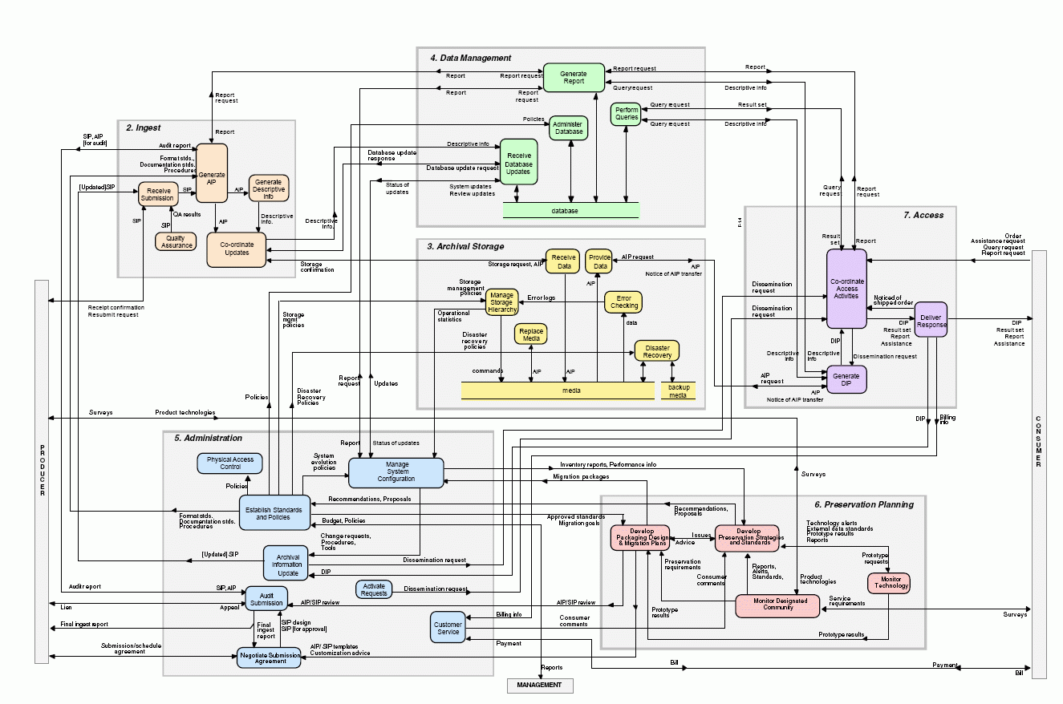
OAIS – detailed view
Notes:
Usually there are several tools that cover the whole OAIS

Slide 18
Useful resources
The Open Archival Information System Reference Model
Recommendation for Space Data System Practices - REFERENCE MODEL FOR AN OPEN ARCHIVAL INFORMATION SYSTEM (OAIS)
ISO 14721:2003
ISO 14721:2012

