Slide 1
South-Eastern European Data Services
Institute for Democracy and Mediation
www.idmalbania.org

Slide 2
Who we are
“Inform, Develop and Motivate for a democratic and prosperous society”
IDM provides expertise, policy analysis, applied research, and capacity building for key societal actors to drive reforms and engage in evidence-based policy processes.
Our mission is to advance societal capacities, generate and provide knowledge, skills and expertise for inclusive policy-making and evidence-based alternatives to bolster democracy and sustainable development.

Slide 3
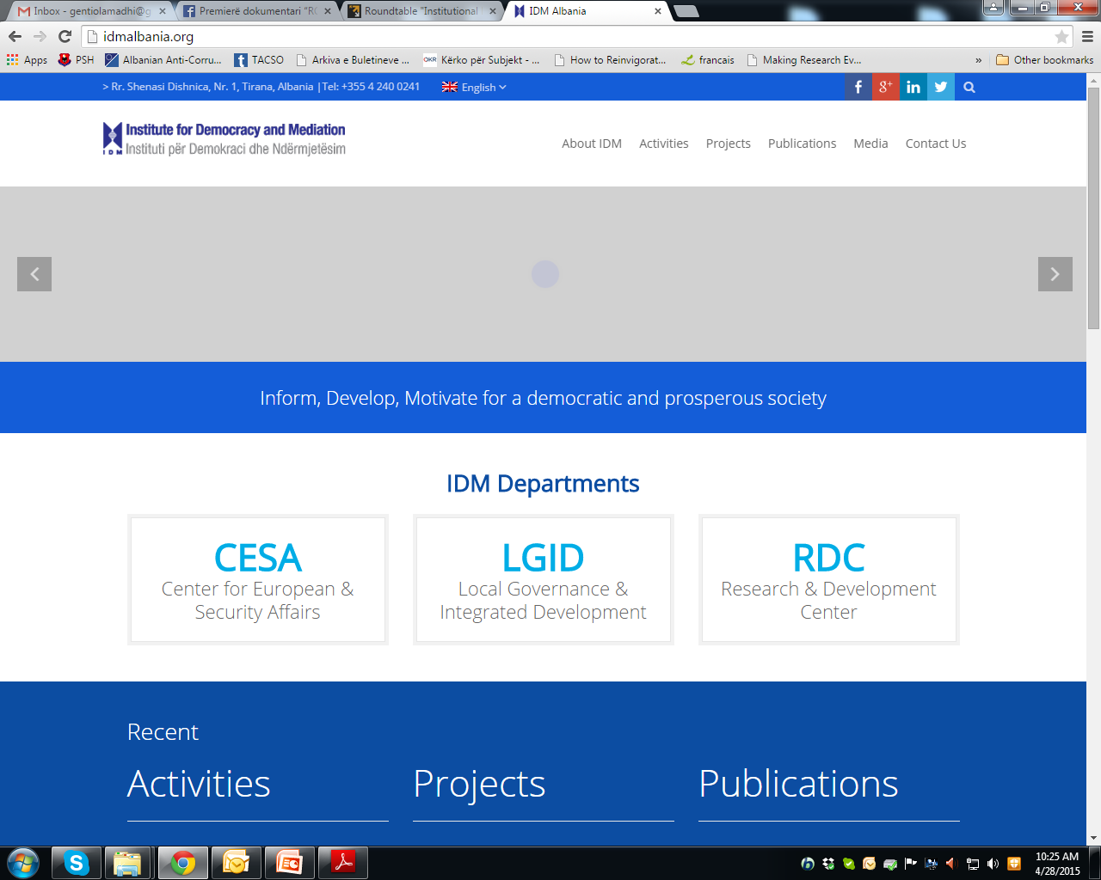

Slide 4
Field of Expertise
By combining the advantages of a knowledgeable think-tank and a resourceful operational non-governmental actor, the Institute’s expertise extends in the following thematic areas:
EU enlargement process with a specific focus on Western Balkans’ accession;
Human capital development, management and result oriented performance;
Good governance, decentralization reforms and inclusive policy processes;
Sustainable integrated development with particular focus on EU development policies;
Consolidation and development of civil society sector as a powerful actor to generate broad consent, values and positive change;
Security sector reform and specialized studies on security issues.

Slide 5
What we do
IDM delivers a broad range of services as follows:
Education and capacity building services specifically tailored for individual target groups, needs and thematic interest;
Research, policy design, analysis and assessment of policy processes, as well as advocacy for evidence-based alternatives to improve governance and sectoral policies;
Advancement of studies, approaches and methodologies for applied research in relation to IDM’s traditional focus areas;
Consultancy and assistance to institutional building and result oriented performance for public authorities, national and international civic and private institutions;
Design and implementation of large-scale information and awareness campaigns.

Slide 6
Research and Development Center
RDC aims to foster scientific research, promote evidence-based policy-making, sustainable development and uphold civil society progress.
RDC engages in examining and supporting civil society development, developing synergies with academia, refining applied research methodologies and knowledge to serve open governance reforms and social development.

Slide 7
National Context (I)
Law on Archives (2003) defines the organization and functioning of the archive service in Albania, the responsible institutions and the legal obligations on the establishment, conservation and usage of the archival resources.
Law on Official Statistics (2004*) regulates the ways of achieving, organizing, issuing and distribution of the official statistics in Albania.
Law on Higher Education (2007*) – Chapter 12 on Scientific Research
Draft Law on “Higher Education and Scientific Research”

Slide 8
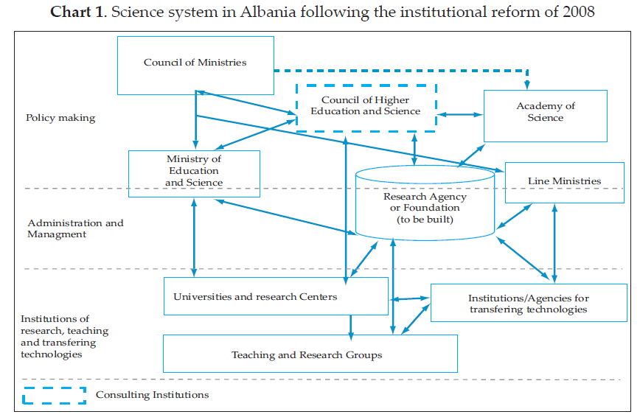
ARTI
Source: Council of Ministers, National Strategy of Science, Technology and Innovation 2009-2015, August 2009, p.10

Slide 9
National Context (II)
Law on Copyright and Related Rights (2005) – Chapter 4 on Database
Law on Personal Data Protection (2008*)
Law on Electronic Signature (2008)
Law on Right to Information (2014)

Slide 10
Thank you for your attention!

