Slide 1
CENTAR ZA MONITORING I ISTRAŽIVANJE
Montenegro
www.cemi.org.me
Lausanne, Switzerland, May 2015

Slide 2
What do we do and why do we do it?
The Centre for Monitoring and Research – CeMI is a nongovernmental, non profitable organization, founded in March 2000, whose main goal is to provide infrastructural and expert support for continuous monitoring of the overall process of transition in Montenegro. It specialises in advocacy, publich policy research (using both qualitative and quantitative methodology) and public policy proposal.
Mission:
CEMI is a think tank organization whose mission is to continuously provide support to reforms and strengthening of the institutions of the political system and civil society organizations through proposing and monitoring the implementation of public policies in the field of human rights and freedoms of European integration and fight against corruption in Montenegro.
Employees:
4 senior researchers
5 junior researchers
PR officer
over 20 external collaborants

Slide 3
How do we organize our work?
CeMI currently operates under three defined programme areas:
Good Governance and Fight against Corruption
Rule of Law and Human Rights
Security and Defense sector reform

Slide 4
How do we organize our work?
Public Opinion Survey Department
Legal Department
Public Relations Department
Public Policy Research Department

Slide 5
Research focus
Elections monitoring:
parliamentary and local elections
referenda
Over the years, CeMI has widen its research focus on various policy areas. These include:
education;
healthcare system;
judicial reform;
security and defense.
electoral reform.

Slide 6
Scientific focus
CeMI currently implements regional scientific project Balkan Comparative Electoral Study: Imapct of Personal Vote on Internal Party Relations The link to project website: www.balkanelectoralstudies.org
Four countries participate in project implementation:
Montenegro
Serbia
Kosovo
Bosnia and Herzegovina
The project is supported by the RRPP, and conducted with mentorship of FORS and University of Lausanne.

Slide 7
Financing of the organization
Organization for Security and Cooperation in Europe (OSCE)
Think Tank Fund, Budapest
European Commission
Policy Association for and Open Society - PASOS
Council for NATO Membership
Regional Research Promotion Programme
EIDHR
Canada Fund GCT Canada
Fundation Friedrich Ebert - 6,900.00 EUR
Commission for Allocation of Part of Incomes from Lottery

Slide 8
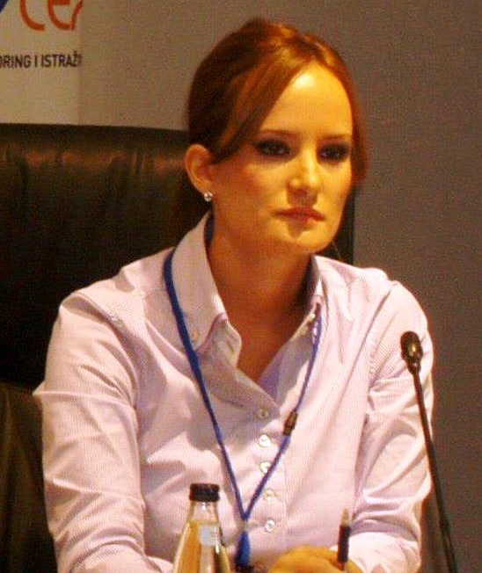
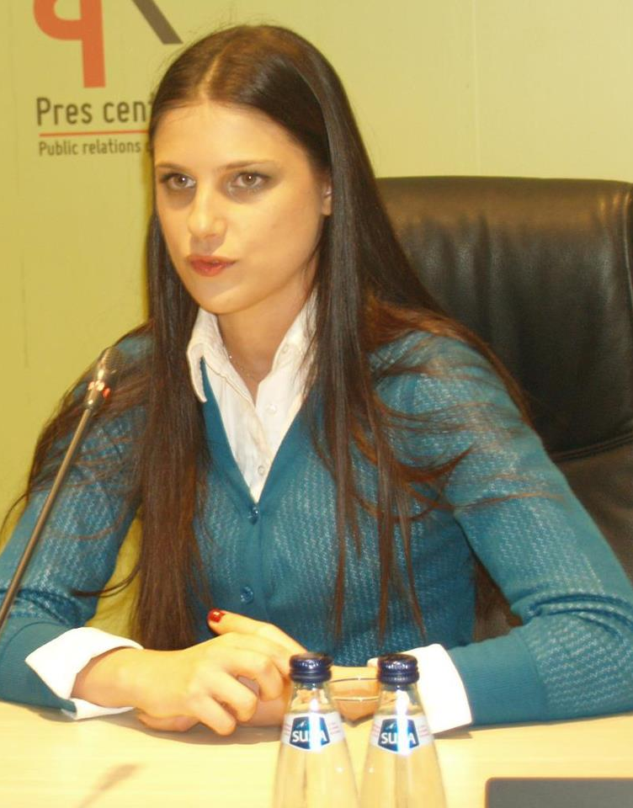
Researchers participating in the SEEDS project
M.Sc. Nikoleta Tomovic Ms. Tomovic is the Executive director of CeMI. She has extensive experience in policy research and research conduct. She is Master of Science in International Relation, and she worked as Advisor at Ministry of Defence of Montenegro.
Ivana Vujović Head of the Public Opinion Survey and President of the Governing Board of one of the largest NGOs in Montenegro – Juventas. She is physician and IT expert.

Slide 9
National Context
Montenegro has closed Chapter 25 in negotiations with EU, which relates to harmonization of science policy and legislation with EU legislation. It committed itself to raise support for scientific projects to 1,4% of GDP.
Research capacities of civil society organizations and universities
Governmental support for research projects in Montenegro
Collaboration with decision-making bodies

