Slide 1
A permanent infrastructure for delivering better access to data
Managing Director
Paul Jackson

Slide 2
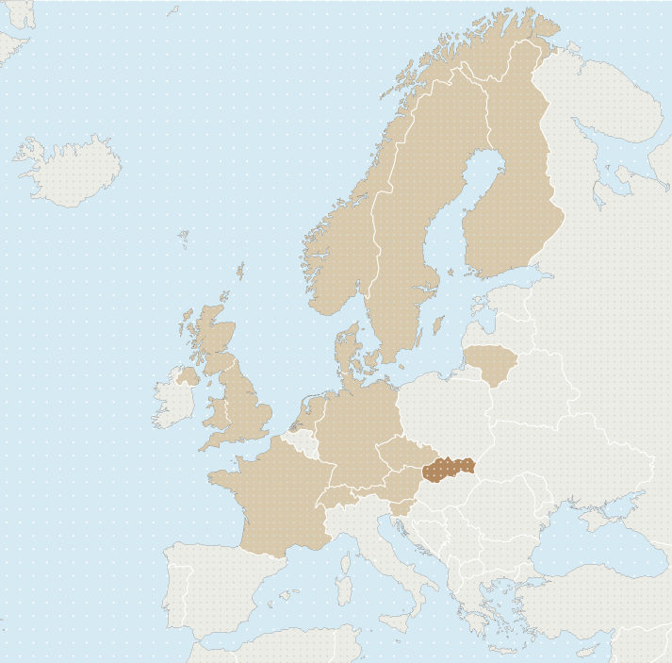
13 CESSDA members:
Austria
Czech Republic
Denmark
Finland
France
Germany
Lithuania
Netherlands
Norway
Slovenia
Sweden
Switzerland
UK
1 observer:
Slovakia
MoUs signed by:
Greece
Belgium
Portugal

Slide 3
Partnerships for the Societal Challenge Inclusive, reflective and innovative societies
The circle of partners…
> Knowledge owners
> Statistics offices, survey takers, data sources
> Data archives and data access services
> Information analysts, providers of insight
> Knowledge users
…has to become transnational

Slide 4
European Partnerships with Research Infrastructure Consortiums
CESSDA to become CESSDA ERIC in 2016
Distributed and integrated, with a strong hub
A legal entity, and a multiplier, with a constitution
Data products and access services to be provided “irrespective of the location of the data or the researcher”

Slide 5
2015 CESSDA Work Programme
Stakeholders have said:
“We need an access portal that doesn’t require researchers to move around Europe to do their research”
- CESSDA Secure Access and Download Portal

Slide 6
2015 CESSDA Work Programme
Stakeholders have said:
“Researchers want a discovery portal with specific search criteria, and to be able to dig down into detail”
- CESSDA Metadata Management Standard
- CESSDA Catalogue

Slide 7
2015 CESSDA Work Programme
Stakeholders have said:
“Researchers want faster access, from anywhere, and through their own workspace”
- CESSDA Secure Access and Download Portal

Slide 8
2015 CESSDA Work Programme
Stakeholders have said:
“Reduce the institutional obstacles especially in form-based approval procedures”
- CESSDA Single Sign-on

Slide 9
2015 CESSDA Work Programme
Stakeholders have said:
“Are relevant questions being asked during accreditation, and are the answers reacted to?”
- CESSDA Authentication and Authorisation

Slide 10
2015 CESSDA Work Programme
Stakeholders have said:
“Researcher want a data Google; machine actionable metadata, DDI based, standards informed, content rich, associated with access, and available through a portal. A centralised infrastructure based on standards is the ideal”
- CESSDA Metadata Harvesting Tool
- CESSDA DDI alignment

Slide 11
2015 CESSDA Work Programme
- CESSDA Product and Service Catalogue
- CESSDA Secure Access and Download Portal
- CESSDA Single Sign On
- CESSDA Authentication and Authorisation
- CESSDA Metadata Management Standard
- CESSDA Virtual Centre of Competence
- CESSDA PI and Citation Standard
- CESSDA Expert Seminar
All managed as projects. All must take into account DwB et al.

Slide 12
Future CESSDA Work
- Each Task launched as a Call
- Bids from CESSDA Service Providers working in partnerships
- User and Service Provider impact assessments required
- Delivery (product and service launches) in 2015/16
- Expect contact. Either consultation, or about your DwB work

Slide 13
Future CESSDA Work
Stakeholders have said:
“When you can get lost in the information jungle, MISSY and ESC training courses have been very useful”
- CESSDA Acceptance into Service Procedure

Slide 14
Future CESSDA Work
Eurostat have said:
“Accreditation procedures to be revised and online, and e-learning material on confidentiality to be provided. Metadata needs improvement and needs to be transmitted. Better communication with researchers is needed. Projects need managed closure. We need to measure benefits”
- CESSDA Collaboration with the ESS

Slide 15
Future CESSDA Work
OECD has said:
“A Circle of Trust, built objectively, makes working in partnerships more effective than working alone”
- CESSDA full DSA certification

Slide 16
2015 / 18 CESSDA Projects
- CESSDA “Strengthening and Widening” bid
(2.5m Euro from June 2015, 2 years)
- SERISS “Synergies in European RIs for Social Sciences”
(2m Euro to CESSDA partners)
- BigDataEurope.
(250k Euro to CESSDA over 3 years)
- Secure Virtual Research Environment
(21st Century user experience. Results unknown yet)

Slide 17
2015/20 CESSDA Tasks
- CESSDA 2020 Strategic Plan
- CESSDA Scientific Strategy
- All members to be Data Seal of Approval certified
- Operationalise the collaboration with the ESS
(Including ESC-OS, MISSY, CIMES, etc)
- Evaluate DASISH and DwB deliverables
- Consider new services (such as ICPSR "SEADS")
- Prepare the 2016 Work Programme (in draft by June)
- Become an ERIC !

Slide 18
Future CESSDA Work
Lots to do.
Too much to do on our own
How should it be done?

Slide 20
How intense are these partnerships to be?

Slide 21
paul.jackson@cessda.net
www.cessda.net

