Slide 1



Building Capacities for Establishment of Social Science Digital Data Archives
Achievements of SERSCIDA Project
Aleksandra Bradić-Martinović,
Institute of Economic Sciences, Belgrade

Slide 2
Belgrade SERSCIDA Conference (March, 2013)
Presentation of Country Assessment Reports for Bosnia and Herzegovina, Croatia and Serbia:
  Policy,
  Infrastructure and
  Researchers' interest in data services
ADP, Ljubljana (April, 2013) – starting point of Road Map - Establishment plan (organization, human resources, technical infrastructure, policies, quality control procedures and workflows) – Policy and Procedures

Slide 3

Trainings
Aim: building the capacities of local SERSCIDA teams based on the knowledge and experience of CESSDA members
  the management structure/personnel to be employed,
  necessary infrastructure – especially IT infrastructure,
  work processes,
  relevant documentation,
  enabling access to data,
  data protection etc.

Slide 4
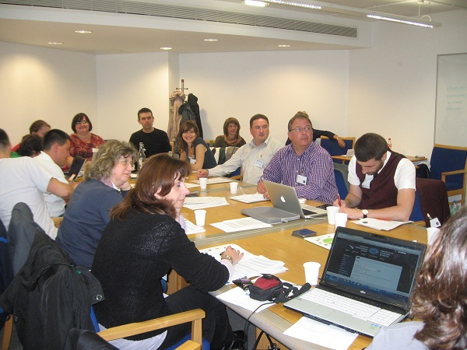
UKDA, Essex (July, 2013)
How to set up and run a data service: the challenges of social science data
Aim: learning digital archives organization and work processes on the UKDA example
  Overview of The UK Data Archive and Services, Capacity and Skills
  Acquisitions Procedures, Data Evaluation and Licensing
  Data Preservation and Security
  Overview of Data and Documentation Processing and Cataloguing - Quantitative and Qualitative Data
  Accessing Data and Supporting Users
  Supporting Data Creators and
  Best Practice In Data Management

Slide 5
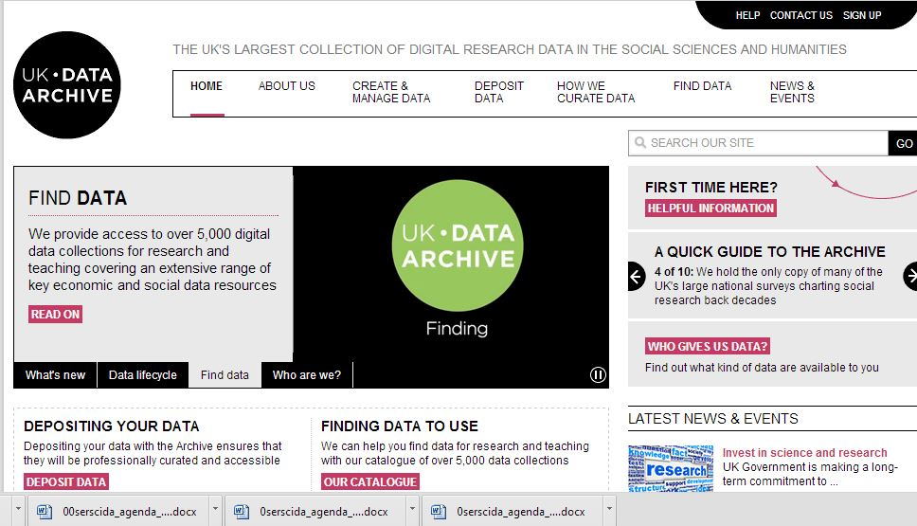
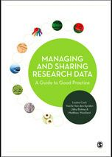
UKDA material

Slide 6
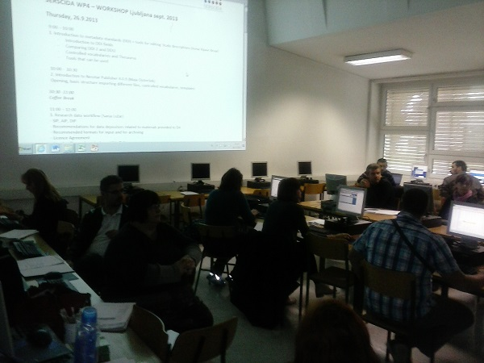
ADP, Ljubljana (September, 2013)
Workshop
Aim: practical work with data
  Introduction to metadata standards (DDI) + tools for editing Study descriptions
  Introduction to Nesstar Publisher 4.0.9
  Research data workflow
  Preparing survey for distribution
  Tools for publishing data and metadata
  Data Acquisition: Sharing your data
  – why and how
  Examples of problematic data

Slide 7
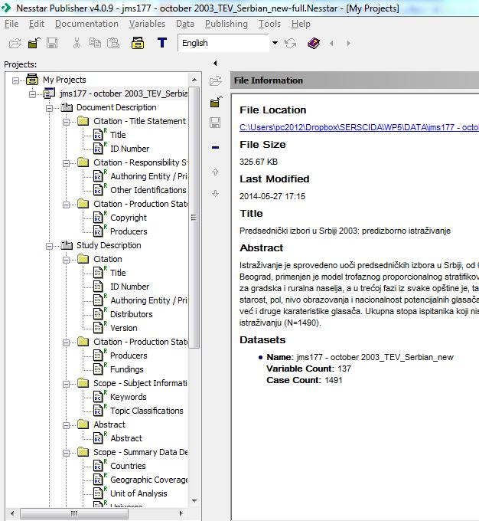
Nesstar Publisher

Slide 8
Working visits
Aim: getting involved all relevant and/or associated institutions that will facilitate the work of digital archives
  Ministries
  Universities
  Research institutions (institutes, faculties)
  Statistical offices
  Libraries

Slide 9
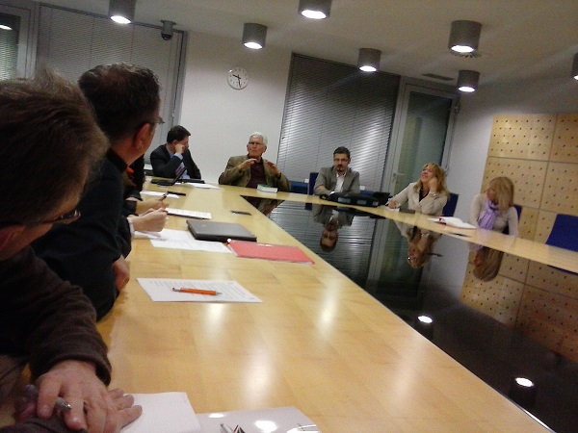
ADP, Ljubljana (October, 2013)
Faculty of Social Sciences
  ADP as connection point between students, professors and students
  First steps of ADP – prof. Toš
Statistical Office of the Republic of Slovenia (SORS)
  Collaboration
  Access to micro data series
  Labor Force Survey
National and University Library (NUK)
  Supporting access and work with data,
  supported by librarians

Slide 10
ADP, Ljubljana (October, 2013)
University of Ljubljana
  Establishment of the policy of demand for Open Access in relation to Inter-University repository
Slovenian Research Agency
  Program for young researchers
  Evaluation in science publication (siCriss, COBISS.SI)
Ministry of Education, Science and Sport
  Importance of Open Access
  For data financed with public funds

Slide 11
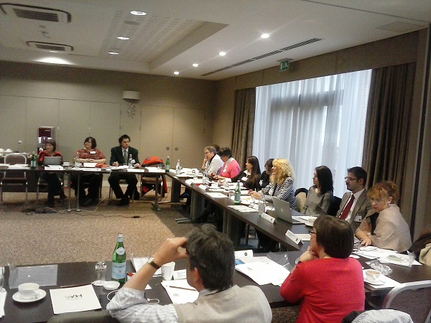
UKDA, Essex (October, 2013)
Data Service and UK Data Archive
  Operational responsibilities of each section
  Secure Lab
International Strategy, Economic and Social Research Council
  Funding
Institute for Social and Economic Research (ISER) University of Essex
Office for National Statistics (ONS)
Social Sciences, University of Essex

Slide 12
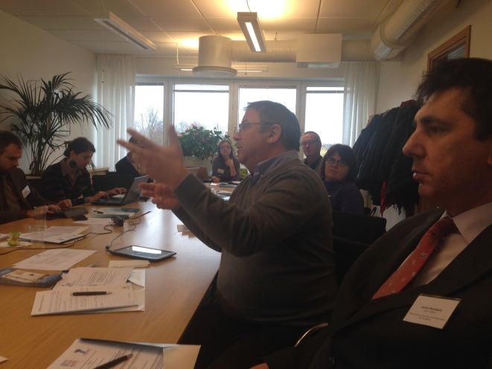
SND, Gothenburg (November, 2013)
SND presentation
  About institution
  Hans Jorgen Marker – ex director of CESSDA
Swedish National Data Service Board
  Funding
  Legal obstacles
Research funding Swedish Research Council
Swedish Statistical Bureau
University of Gothenburg

Slide 13
Other events + one in 2015
DwB (FP7 – Data Without Boundaries) workshop, Ljubljana (April, 2013)
  Microdata access in European countries - cooperation between national statistical institutes and social science data archives
IASSIST conference, Cologne (May, 2013)
  Session: Making new connections: developing data services in Bosnia and Herzegovina, Croatia, and Serbia
CESSDA Trust 2nd Workshop, GESIS, Cologne (October, 2013)
  Data Seal of Approval (DSA)

Slide 14
Other events + one in 2015
CESSDA Expert Seminar, WISDOM, Vienna (November, 2013)
  Research Data Management: Cost and Incentives
CESSDA Expert Seminar, UKDA, Colchester (November, 2014)
  Research integrity - a digital curation problem?

Slide 15
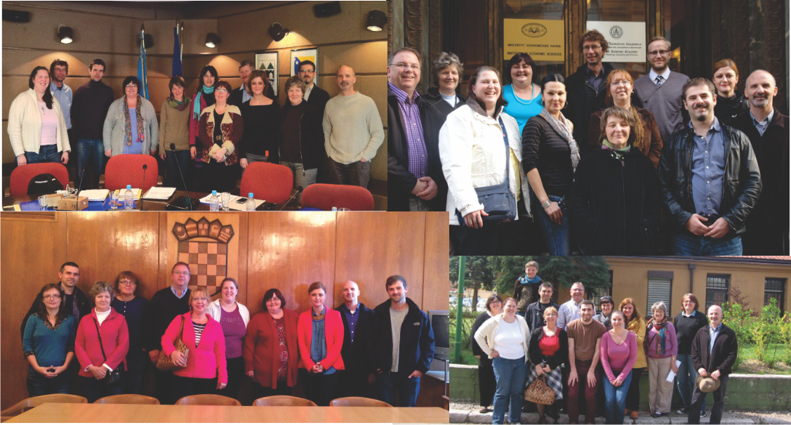
SERSCIDA team

Slide 16
Thank you for your attention
Aleksandra Bradić-Martinović

